Slide 1
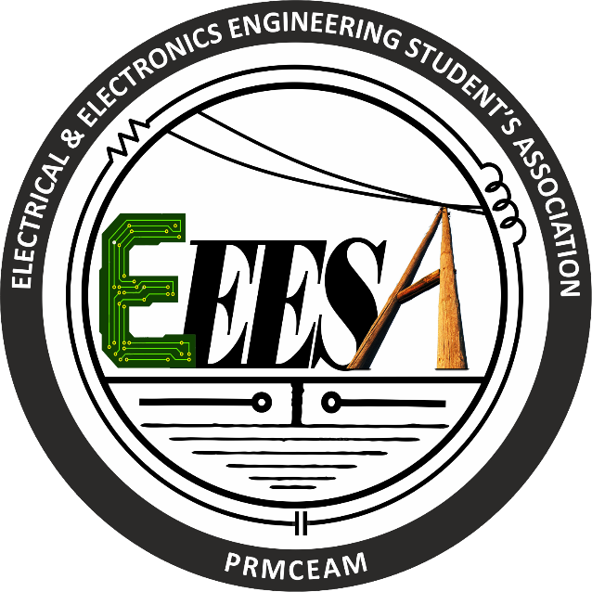
VIDRBHA YOUTH WLFARE SOCIETY'S
PROF RAM MEGEH COLLEGE OF ENINEERING AND MANGEMENT
BADNERA-AMRAVATI
ONE DAY WORKSHOP ON IoT
(Internet of thing)
Organized by EEESA
(Electrical and Electronics Student’s Association)

Slide 2
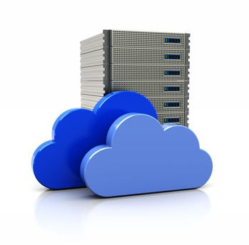
What is Mean by cloud & server?

Slide 3
Five basic difference between cloud and server….
Availability
Scalability of resources
Safety and security
Cost-efficiency
Level of control

Slide 4
CLOUD | SERVER
Cloud servers never go down as in case of any issue | There’s risk of downtime and hardware failure
one does not have complete control and is limited to offerings provided by the service provider. | A dedicated server offers complete control over the server as one can add applications, programs and performance enhancing measures to the machine.
Increase RAM, storage accordingly workload is easy. | Increase RAM, storage accordingly workload is difficult.
You pay only for the computing resources that you actually use | billed monthly and you have to pay a consistent amount irrespective of how much server and resources you actually use.

Slide 5
What is IoT?

Slide 6
Internet of Things (IoT) is the network of physical devices, vehicles, home appliances, and other items embedded with electronics, software, sensors and connectivity which enables these things to connect and exchange data, creating opportunities for more direct integration of the physical world into computer-based systems, resulting in efficiency improvements, economic benefits, and reduced human exertions.

Slide 7
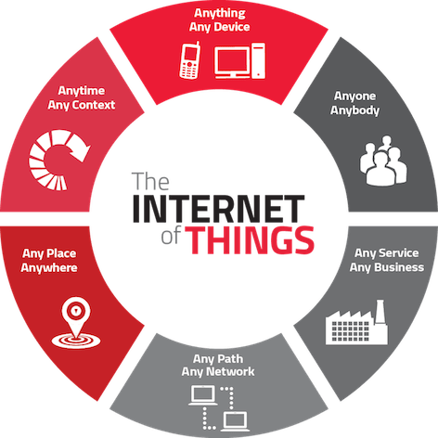

Slide 8
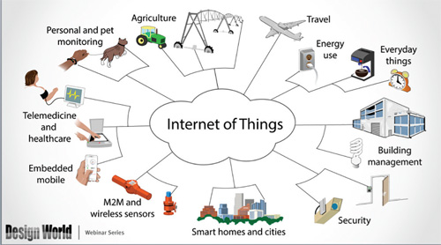
Application:-

Slide 9
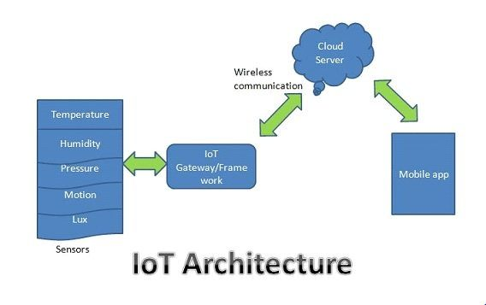
Architecture:

Slide 10
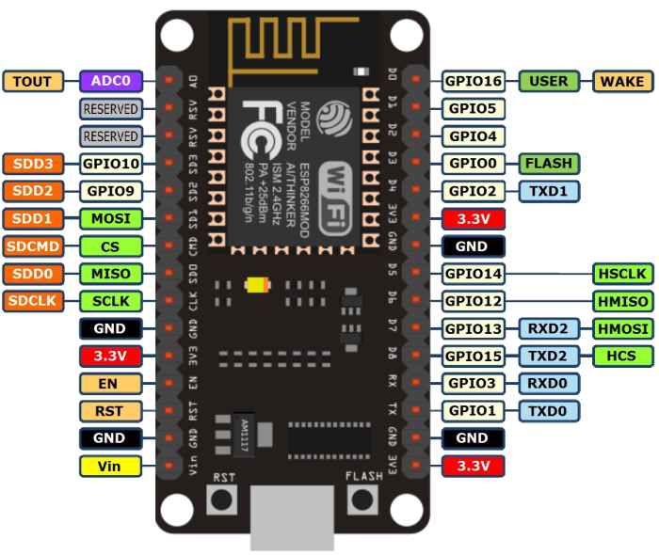
NodeMCU layout:-

Slide 11
Project:- Controlling of LED…..

Slide 12
